Slide 1
RASEN Process for Cyber-risk Assessment
Bjørnar Solhaug
Oslo, 2015-02-05

Slide 2
Background
We need to answer:
  What is cybersecurity?
  What is cyber-risk?
  What is cyber-risk assessment?
  How can we instantiate the RASEN process with respect to cyber-risk?

Slide 3
What is Cybersecurity About?
Usual suspects
  Security in cyberspace
  Internet security
  Information security
  Infrastructure security
  Critical information infrastructure protection
  Cyber-attacks
  …

Slide 4
Risk Terms
A risk is the likelihood of an incident and its consequence for an asset
A vulnerability is a weakness, flaw or deficiency that may be exploited by a threat to cause harm to an asset
A threat is an action or event that is caused by a threat source and that may lead to an incident
  E.g. attack
A threat source is the potential cause of an incident
  E.g. attacker

Slide 5
Risk Assessment

Slide 6
Cyber-systems
A cyberspace is a collection of interconnected computerized networks, including services, computer systems, embedded processors and controllers, as well as information in storage or transit
  The cyber-domain is not the same as the Internet domain
  The Internet is an example of a cyberspace
A cyber-system is a system that makes use of a cyberspace

Slide 7
Cybersecurity
Cybersecurity is the protection against cyber-threats
A cyber-threat is a threat caused by a threat source that makes use of or exploits a cyberspace
  A threat is an action or event that is caused by a threat source and that may lead to an incident.
    E.g. SQL injection or DoS attack
  A threat source is the potential cause of an incident.
    E.g. hacker or Trojan

Slide 8
Cybersecurity vs.
Information security
Information security is the preservation of CIA
  Information can be in any form, threats can be of any kind
Cybersecurity is the protection of threats due to a cyberspace
  Cyber-threats may target information assets, but only those that can be targeted via cyberspace
  Cybersecurity is moreover not limited to the protection of information assets alone
Cybersecurity and information security overlap, but they are not the same

Slide 9
Cybersecurity vs.
Critical Infrastructure Protection
Infrastructure security and critical (information) infrastructure protection are concerned with the
prevention of the disruption, disabling, destruction or malicious control of infrastructure
  Telecommunication, transportation, finance, power supply, water supply, emergency services
Many critical infrastructures makes use of a cyberspace, and therefore needs protection from cyber-threats
However, CIP goes beyond the protection from cyber-threats
Cybersecurity and CIP overlap, but are not the same

Slide 10
Cybersecurity vs.
CIP and Information Security

Slide 11
Cyber-risk Assessment
What is the "cyber" in each step?

Slide 12
Context Establishment
Target: What is the cyber-system in question?
Assets: What is it that we seek to protect and that may be vulnerable due to cyberspace?
How does the system interact with cyberspace?
  What is the interface to cyberspace?
  What is the attack surface?
  What are the remote and local entry points?

Slide 13
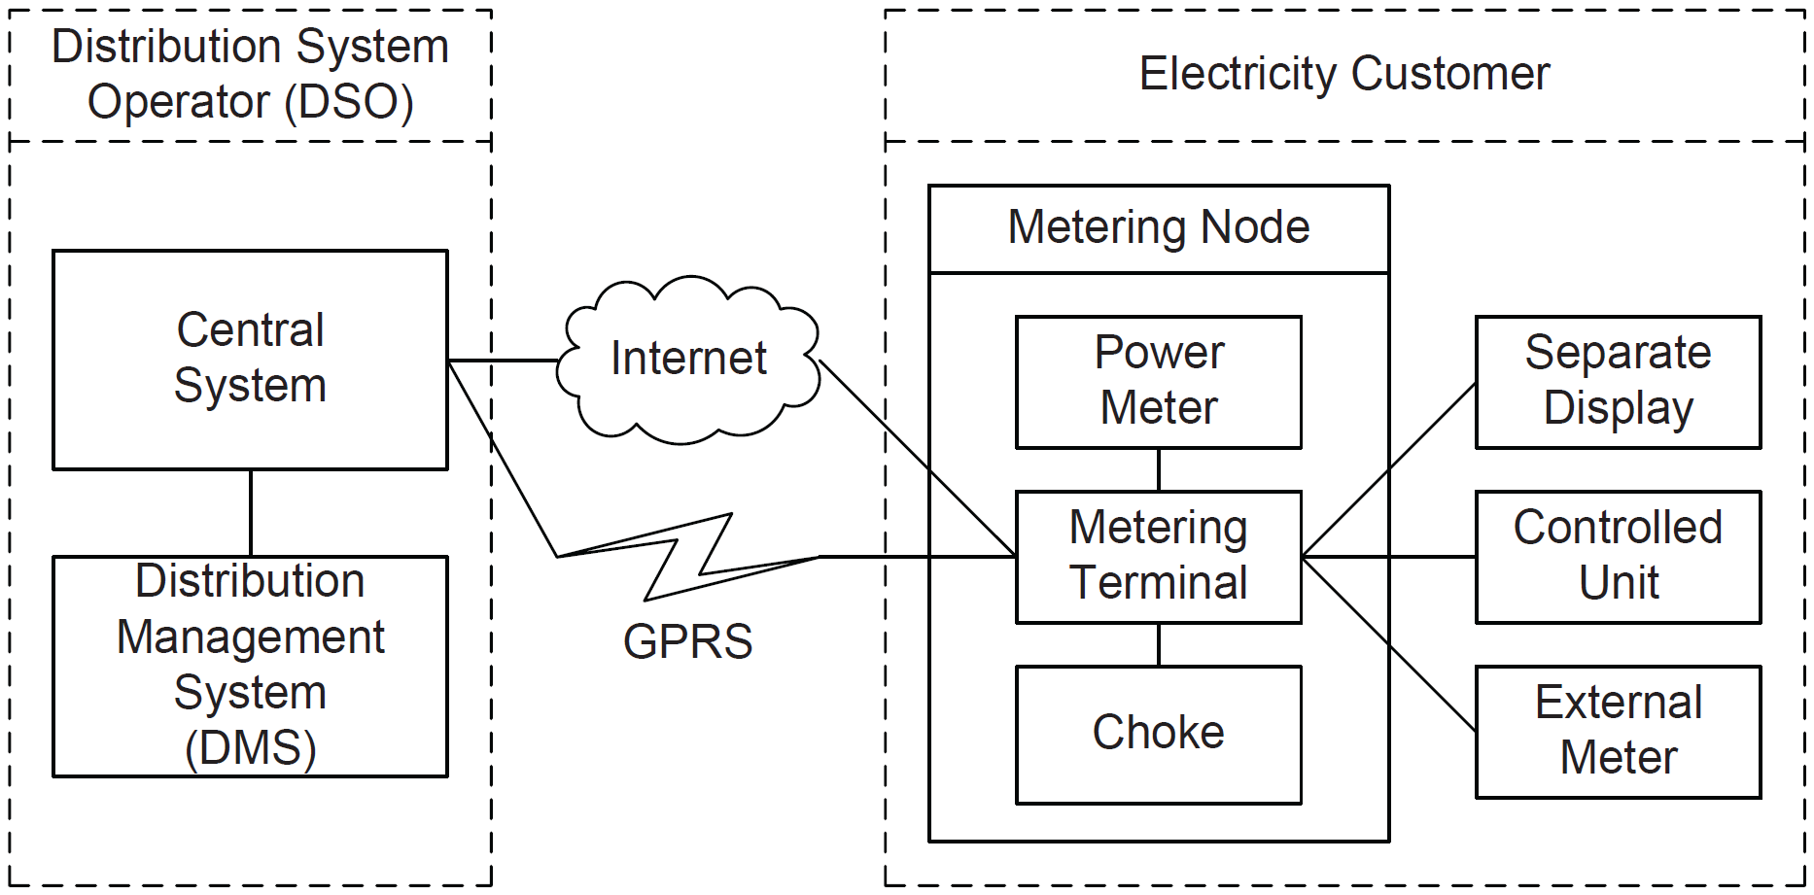
Example: Smart Grid
Remote entry points
Local entry point (example)

Slide 14
Cyber-risk Identification
What are the threats?
What are the vulnerabilities?
What are the incidents?

Slide 15
Threat Identification
What are the potential threats, and which threat sources cause them?
We distinguish between malicious threats and non-malicious threats
  We need different risk assessment techniques depending on the kind of threat
  Human threat sources with intention (attackers) are less predictable

Slide 16
Malicious Threats
Brainstorming, interviews, logs, historical data, etc. regarding the specific target are always relevant
Make also systematic use of lists and repositories
  CAPEC, OWASP, Top 10 security threats,…
Decide a format for threat specification
  E.g. threat source, capabilities, motivation, resources, skills, attack prerequisites, attack method,…

Slide 17
Vulnerabilities
For each threat, what are the potential vulnerabilities?
Again we can make use of available lists and repositories, such as MITRE and OWASP
We can also make use of various techniques
  Penetration testing, vulnerability testing, vulnerability scans, security test patterns, test selection, …

Slide 18
Incidents
For each threat and the vulnerabilities it exploits, what are the incidents it can lead to?
Repositories and techniques such as testing are useful also here

Slide 19
Cyber-risk Analysis
What are the likelihoods and consequences of the identified incidents?
We do the analysis separately for the malicious and the non-malicious threats

Slide 20
Threat Analysis
Malicious threats
  Often difficult to estimate the likelihood of an attack directly
  We can instead make use of our threat specification and measure malicious threats by different factors
    Capability, motivation, skills, resources,…
    We need a scale for each factor, as well as techniques for aggregating the measures
  We can also use as input the measures provided by available repositories
Non-malicious threats
  Data regarding non-malicious threats are often available

Slide 21
Vulnerability Analysis
Vulnerability analysis wrt. malicious threats
  Can also here decompose into a set of factors
    Prevalence, attack frequency, ease of detection, attacker awareness, ease of exploit, intrusion detection,…
    We need a scale for each factor, as well as techniques for aggregating the measures
Vulnerability analysis wrt. non-malicious threats
  Often easier to measure these, but if needed we may use a set of factors also here

Slide 22
Incident Analysis
We make use of the results of the threat and vulnerability analysis to analyze likelihood and consequence of incidents
Threats and vulnerabilities together determine the likelihood of incidents
They also facilitate the consequence estimation
Some repositories provide data on typical severity and likelihood

Slide 23
What is the interface and interaction with cyberspace?
What is the attack surface?
What are the entry points?
What are the threats, vulnerabilities and incidents?
Distinguish between malicious and non-malicious
Decide on how to characterize and specify the findings
Make use of lists and repositories
Exploit the fact that we are dealing with computer systems
Determine risk levels based on threat and vulnerability analysis
Conduct the analysis by making use of known factors
Gather data from available sources and by use of techniques such as testing and monitoring

Slide 24
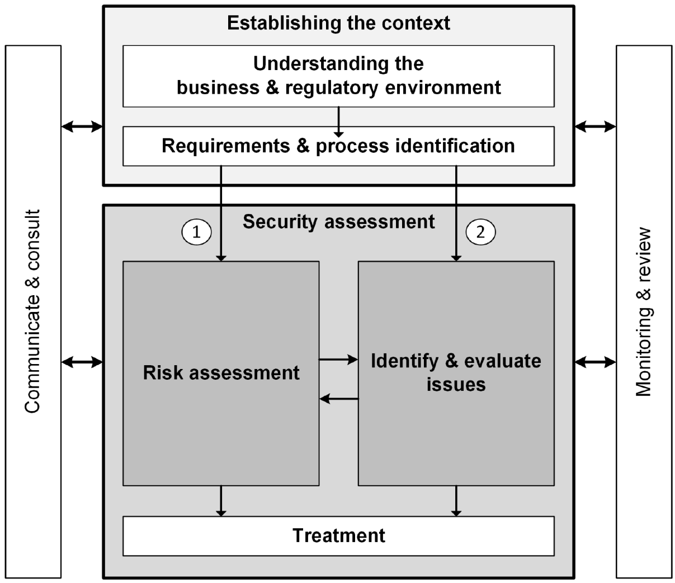
Adapting the RASEN Process to Cybersecurity
We can instantiate the overall RASEN process wrt. cyber-risk assessment
From this we get instances also of the specific RASEN methodologies
  Combining compliance and cyber-risk assessment
  Cyber-risk-based security testing
  Test-based cyber-risk assessment

