Slide 1
The RASEN tool-supported method for risk-based security testing and compliance assessment
Notes:
Formatting:
Language: Set proofing language to English (U.S.) in all slides
In this title slide, use capitalization of first letters in <Full Name of WP> and in <Subtitle for the Presentation>
Write the name and affiliation of the presenter(s) to the left. Only first letter of first name(s) and full family name.

Slide 2
RASEN method
Security Risk Assessment
Security Testing
Compliance Assessment
Focus on:
Risk-based compliance assessment
Test-based security risk assessment
Risk-based security testing

Slide 3
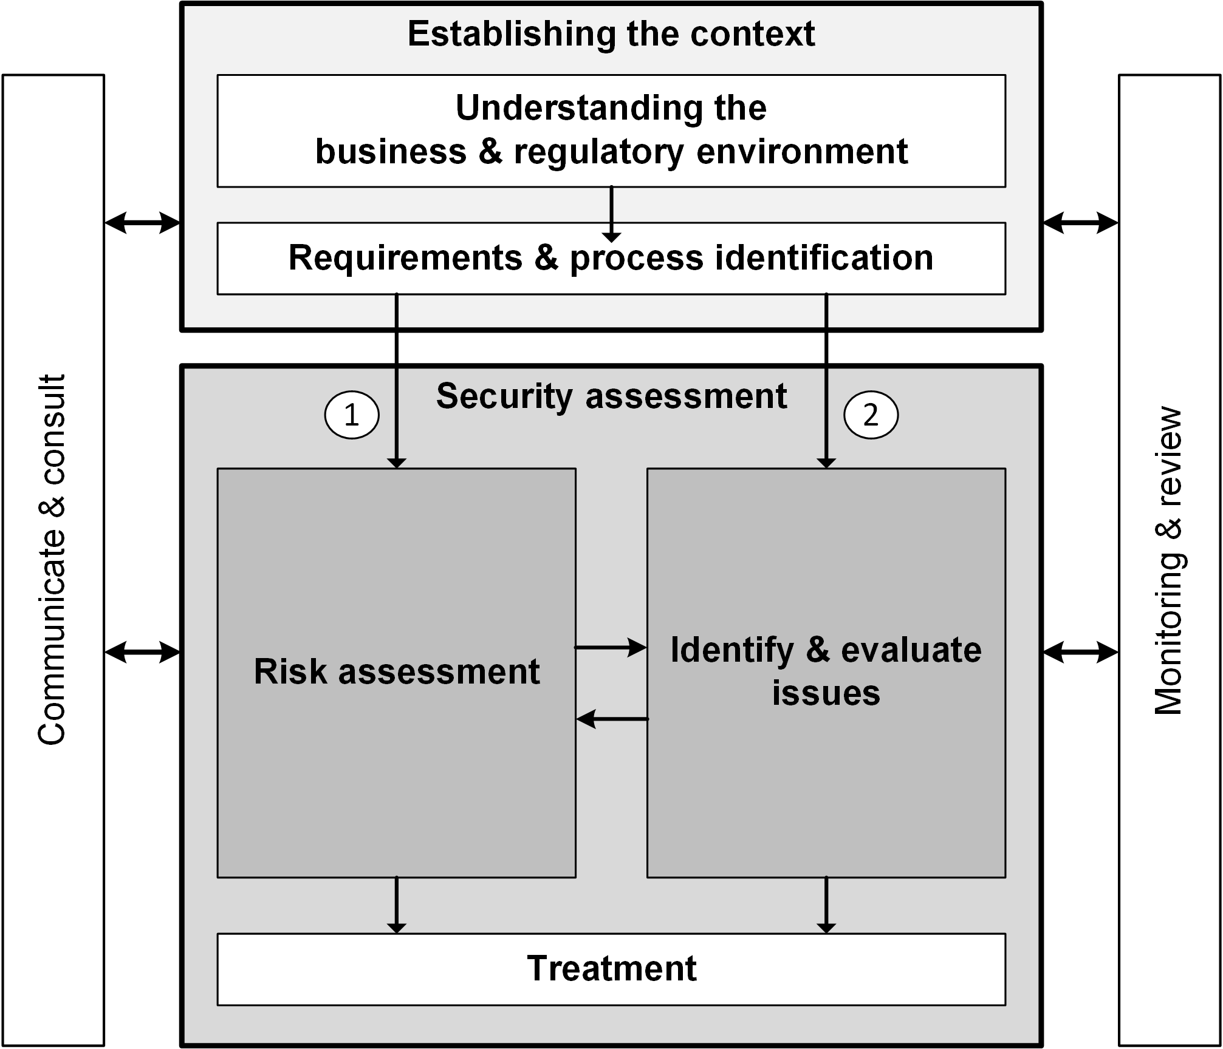
Security testing, risk & compliance assessment
Conforms to ISO/IEC 31000
Integrates risk assessment, compliance assessment and security testing
Applicable to different level of abstraction:
  Legal risk and compliance assessment,
  Security risk assessment, and
  Security testing

Slide 4
Two entry points
A test-based or compliance based security risk assessment process (1)
starts with the risk assessment
is used to optimize security risk assessment with empirical data coming from test results or compliance issues.
A risk-based method for compliance and security testing (2)
starts with the identification of issues by security testing or compliance assessment
focus the compliance and security testing resources on the areas that are most likely to cause concern
building and prioritizing the compliance measures or testing program around these risks.

Slide 5
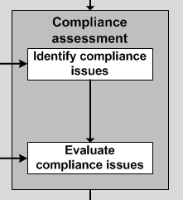
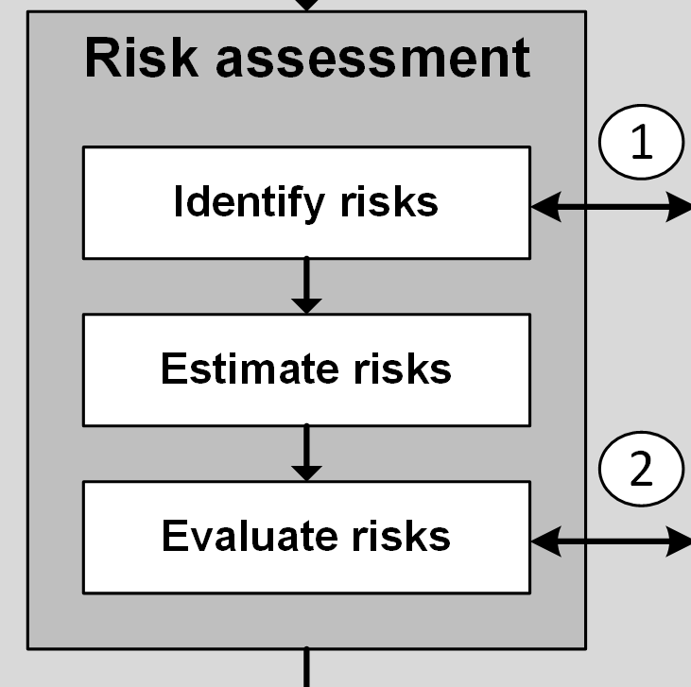
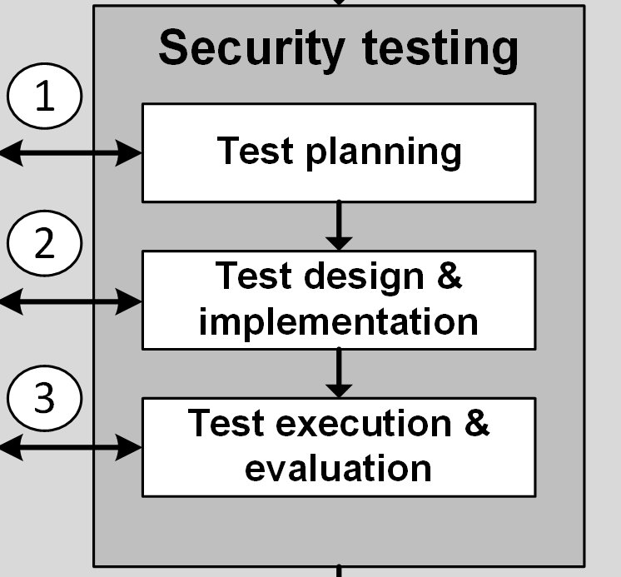
Different instantiation
Risk-based
compliance assessment
Test-based risk assessment
Risk-based security testing

Slide 6
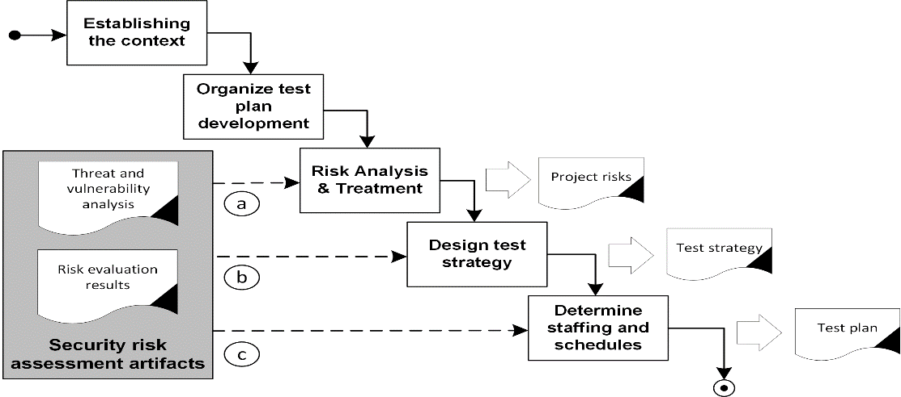
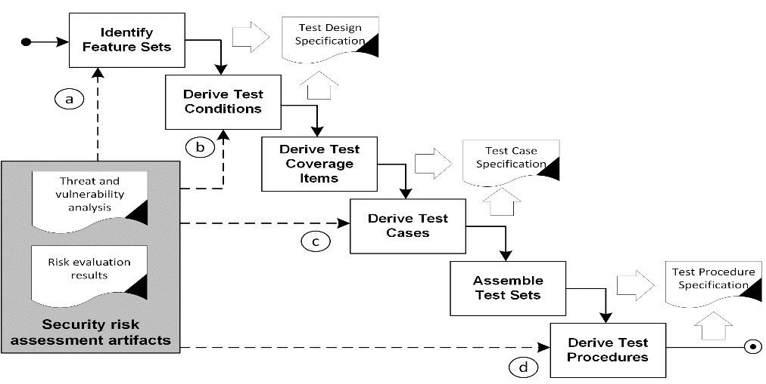
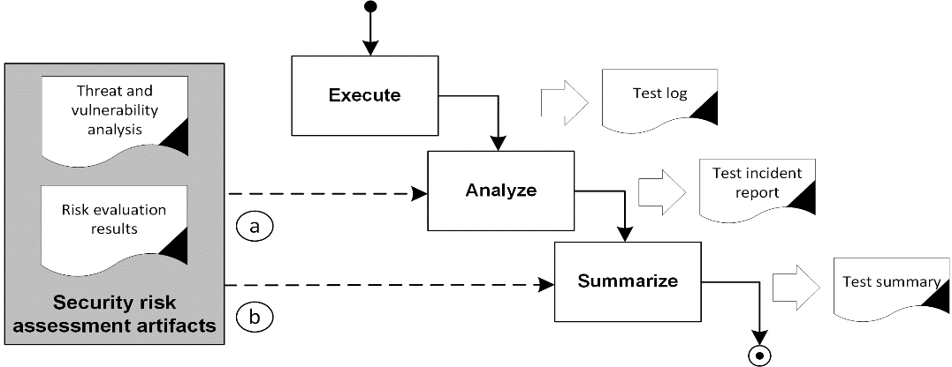
Risk-based security testing
Integration with ISO 29119
Risk-based
security test planning
Risk-based
security test
design and implementation
Risk-based security test execution and evaluation

Slide 7
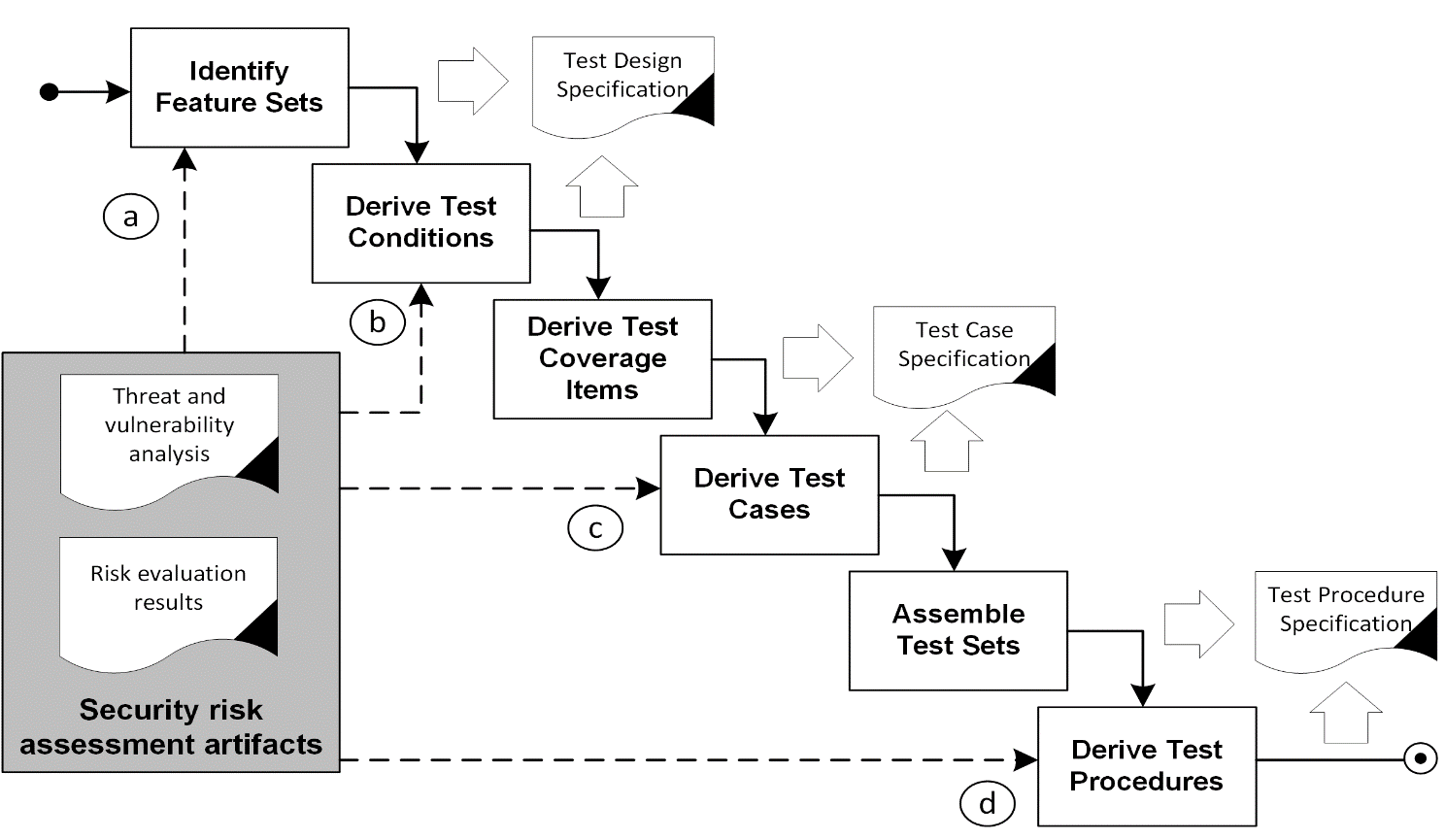
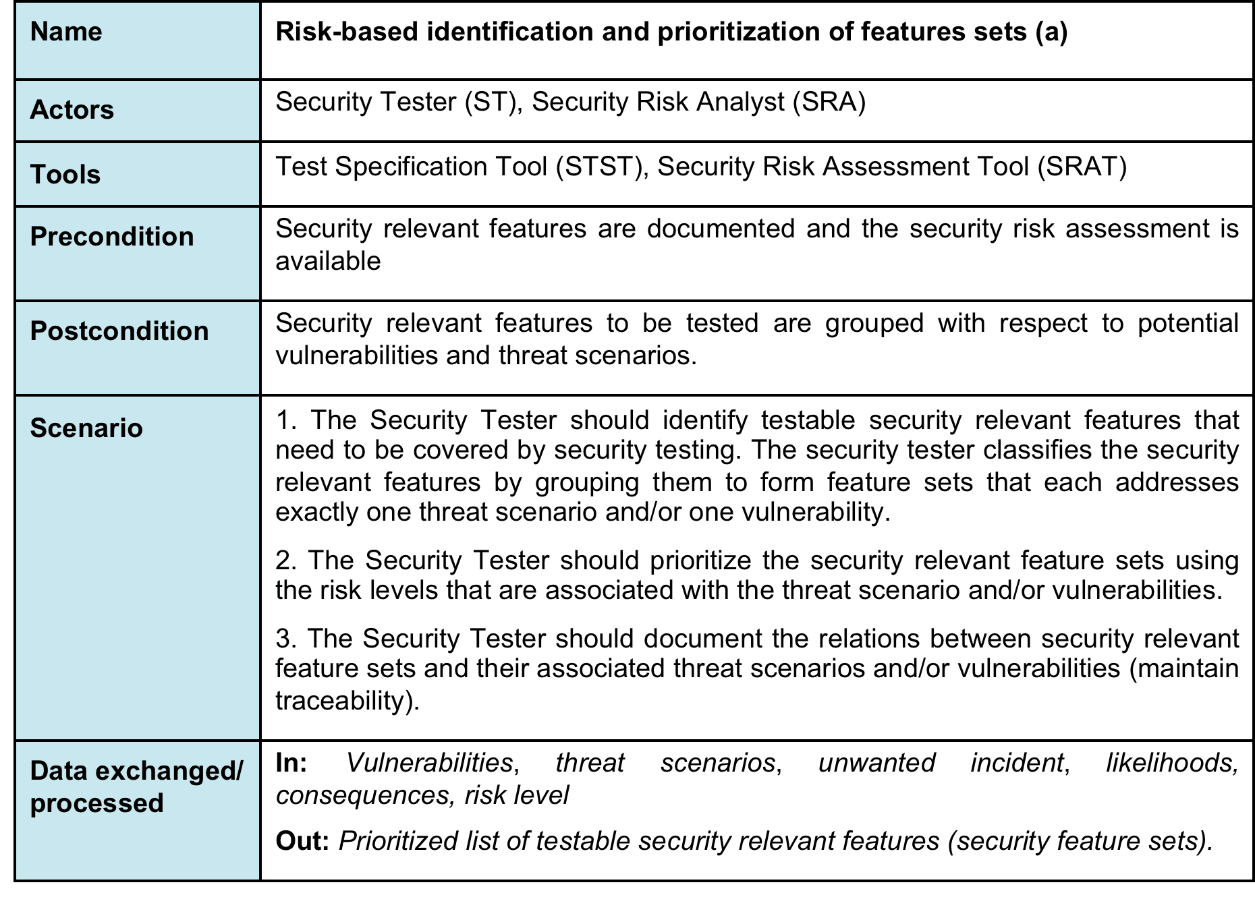
Specified in detail
Environment
Pre-and Postconditions
Scenario

Slide 8




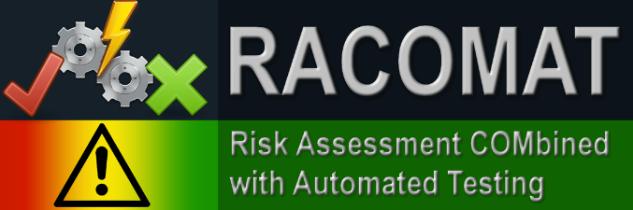
Tool support
RACOMAT

Slide 9
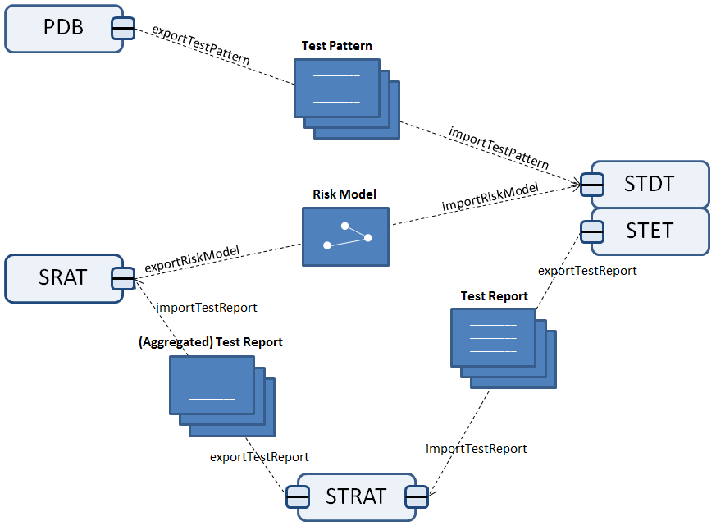


RASEN toolbox
Flexible
coupled tools
Exchange formats to allow data interoperability

Slide 10
RASEN XML-based exchange format
Foundation.xsd
TestPattern.xsdx
RiskModel.xsd
TestReport.xsd

Slide 11
RASEN method summary
Covers the integration of security testing, risk & compliance assessment
Is concisely specified and supported by tools
Is mature and powerful
  applied to all case studies
  integrates with recent risk assessment and testing standards
  constitutes standardization work item at ETSI

Slide 12
          THANK YOU!
      Questions and Comments?

