Slide 1
A Technique for Risk-Based Test Procedure Identification, Prioritization and Selection
ISOLA 2014
Presenter: Johannes Viehmann
Author: Fredrik Seehusen

Slide 2
Overview
What are risks graphs?
How do we derive test procedures from risk graphs?
How do we prioritize test procedures?
How do we select test procedures for test design, implementation, and execution?
Notes:
+ In this talk, we will answer the following questions:

Slide 3
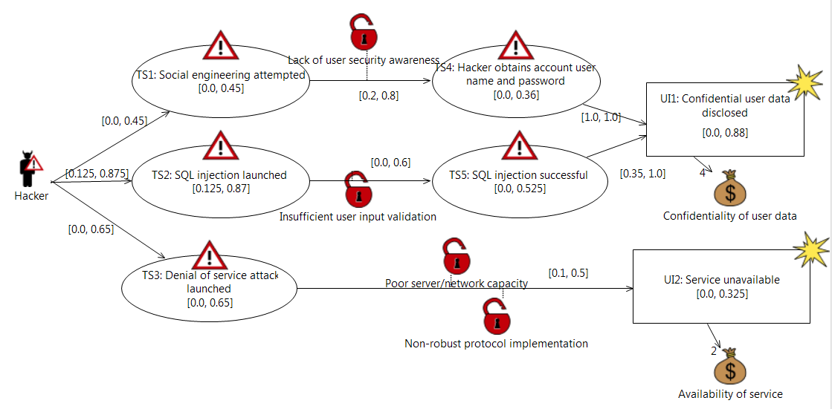
What are risks graphs?
Node
Arrow
Likelihood
Conditional likelihood
Consequence
Notes:
+ A risk graph is a set of nodes and arrows/transitions.
+ The nodes represent events and the arrows represent causal relationships between events.
+ Nodes may have likelihoods that specify how often events occur and consequences that specify the consequence if events occur.
+ Nodes with likelihoods and consequences are considered as risks.
+ Arrows may have conditional likelihoods.
+ The diagram shown on the slide is a CORAS threat diagram. This can be seen as an instance of a risk graph.

Slide 4
How to test a risk graph?
Arrow statement: Check that "Social engineering attemted leads to Hacker obtains account user name and password with likelihood [0.2, 0.8]"
Node statement: Check that "Social engineering attempted occurs with likelihood [0.0, 0.45]"
Path statement: Check that "Hacker initiates Denial of service attack launched with likelihood [0.0, 0.65], then Denial of service attack launched leads to Service unavailable with conditional likelihood [0.1, 0.5]
Notes:
+ A risk graph can be seen as a set of statements about the world.
+ Testing a risk graph corresponds to checking the degree to which these statements are true.
+ Consequently, every statement X of a risk graph corresponds to a test procedure description of the form:
"Check the degree to which X" is true, or just "Check X".
+ There are three different kinds of statements which can be derived from a risk graph (show animation): Node Statements
(statements derived from the nodes), Edge statements (statements derived from the edges), Path statements (statements derived from the paths).
+ We prefer to use the edges as the starting point for test procedure derivation

Slide 5
How to test a risk graph?
Test procedure
Check that SQL injection launched leads to SQL injection successful with conditional likelihood [0.0, 0.6], due to vulnerability Insufficient user input validation.
Check that Hacker initiates SQL injection launched with likelihood [0.125, 0.875].
Check that Hacker initiates Social engineering attempted with likelihood [0.0, 0.45].
Check that SQL injection successful leads to Confidential user data disclosed with conditional likelihood [0.35, 1.0].
Check that Social engineering attempted leads to Hacker obtains account user name and password with conditional likelihood [0.2, 0.8], due to vulnerability Lack of user security awareness.
Check that Hacker initiates Denial of service attack launched with likelihood [0.0, 0.65].
Check Denial of service attack launched leads to Service unavailable with conditional likelihood [0.1, 0.5], due to vulnerabilities Poor server/network capacity and Non-robust protocol implementation.
Check that Hacker obtains account user name and password leads to Confidential user data disclosed with conditional likelihood [1.0, 1.0].
Notes:
+ This slide shows all the test procedures that have been derived from the edges of the previous diagram.
+ These are all the potential test procedures of the risk graph.
+ In practice, we may not have time to test all of these. We have therefore developed a technique for prioritizing these based on risk information.

Slide 6
How to test a risk graph?
Min: 0.2
Min: [0.0, 0.09]
Min : [0.0, 0.62]
Max: 0.8
Max: [0.0, 0.36]
Max: [0.0, 0.88]
Min risk value: rv([0.0, 0.62], 4) = [0.0, 2.48]
Max risk value: rv( [0.0, 0.88], 4) = [0.0, 3.56]
Sensitivity = diff([0.0, 2.48], [0.0, 3.56] ) = 1.1664
Notes:
+ The priority of a given test procedure/edge is calculated by looking at how changes in the conditional likelihood of the edge will impact the risk values of the risk graph.
+ We assume that the likelihood values of the edge are given as confidence intervals.
+ The intuition is that we think the actual likelihood is within the specified interval, but not outside the interval.
+ We look attesting as a means of gaining new knowledge that allows us to estimate the confidence interval more precisely.
+ If changes in the confidence interval of an edge has a big impact on the risk values of the risk graph, then the edge should be prioritized for testing.
+ For a given edge, the procedure for deriving its sensitivity score (which is used for prioritization) is as follows (SHOW ANIMATON):
++ Set the likelihood of the edge to its minimum likelihood value
++ Recalculate the likelihood values of the risks in the risk graph. Call the new risk values the min risk values.
++ Set the likelihood of the edge to its maximum likelihood value
++ Recalculate the likelihood values of the risks in the risk graph. Call the new risk values the max risk values.
++ Calculate the difference between the min and max risk values.
+ This distance is called Sensitivity, and the higher it is, the higher the priority of the edge.

Slide 7
How to prioritize the test procedures?
Priority | Test procedure | Sensitivity
1 | Check that SQL injection launched leads to SQL injection successful with conditional likelihood [0.0, 0.6], due to vulnerability Insufficient user input validation. | 4.421
2 | Check that Hacker initiates SQL injection launched with likelihood [0.125, 0.875]. | 3.240
3 | Check that Hacker initiates Social engineering attempted with likelihood [0.0, 0.45]. | 2.203
4 | Check that SQL injection successful leads to Confidential user data disclosed with conditional likelihood [0.35, 1.0]. | 1.863
5 | Check that Social engineering attempted leads to Hacker obtains account user name and password with conditional likelihood [0.2, 0.8], due to vulnerability Lack of user security awareness. | 1.166
6 | Check that Hacker initiates Denial of service attack launched with likelihood [0.0, 0.65]. | 0.439
7 | Check Denial of service attack launched leads to Service unavailable with conditional likelihood [0.1, 0.5], due to vulnerabilities Poor server/network capacity and Non-robust protocol implementation. | 0.270
8 | Check that Hacker obtains account user name and password leads to Confidential user data disclosed with conditional likelihood [1.0, 1.0]. | 0.0
This is the value we calculated in the example
Notes:
+ We now have a way of calculating the sensitivity of each test procedure (SHOW ANIMATION)
+ The sensitivity score is used to order the test procedures in a prioritized list.
+ Since we may not have to test all the test procedures, the question is still which of these test procedures should we test if we don’t have time to test all of them?
+ To answer this question, we need to know how much effort we have available for testing, and we need to know how much effort it would take to implement and execute each test procedure.

Slide 8
How to select test procedures?
Effort: 1 day
Effort: 7 days
Effort: 2 days
Effort: 2 days
Effort: 4 days
Notes:
+ To indicate how much effort it would take to implement and execute each test procedure, we annotate the edges the risk graph with effort annotations (SHOW ANIMATON).
+ Edges that are not given effort annotations are assumed to by out of scope of the testing given the tools and resources available for testing.

Slide 9
How to select test procedures?
1 and 4 are selected if a maximum of 4 days is available for testing
Priority | Test procedure | Sensitivity | Effort
1 | Check that SQL injection launched leads to SQL injection successful with conditional likelihood [0.0, 0.6], due to vulnerability Insufficient user input validation. | 4.421 | 2 days
2 | Check that Hacker initiates SQL injection launched with likelihood [0.125, 0.875]. | 3.240 | N / A
3 | Check that Hacker initiates Social engineering attempted with likelihood [0.0, 0.45]. | 2.203 | N / A
4 | Check that SQL injection successful leads to Confidential user data disclosed with conditional likelihood [0.35, 1.0]. | 1.863 | 2 days
5 | Check that Social engineering attempted leads to Hacker obtains account user name and password with conditional likelihood [0.2, 0.8], due to vulnerability Lack of user security awareness. | 1.166 | 7 days
6 | Check that Hacker initiates Denial of service attack launched with likelihood [0.0, 0.65]. | 0.439 | N /A
7 | Check Denial of service attack launched leads to Service unavailable with conditional likelihood [0.1, 0.5], due to vulnerabilities Poor server/network capacity and Non-robust protocol implementation. | 0.270 | 4 days
8 | Check that Hacker obtains account user name and password leads to Confidential user data disclosed with conditional likelihood [1.0, 1.0]. | 0.0 | 1 day
Notes:
+ Given effort estimates for each edge, and an estimate of the maximum time available for testing, we can calculate the optimal test selection.
+ We say that a valid test procedure selection is a subset of set of all potential test procedures satisfying the condition that its total effort (obtained by summing the effort values of all its test procedures) is below the maximum available effort
+ An optimal procedure selection is defined as a valid test procedure selection satisfying the condition that there are no other valid test procedure selections that have a higher sensitivity score (obtained by summing all the sensitivity of the selection)
+ If we assume that we have a maximum of four days available for testing, then the optimal test procedure selection of the example with be the test procedures with priority 1 and 4 (SHOW ANIMATION)

Slide 10
Conclusion
We have presented a technique for deriving prioritized test procedures from risk graphs
The technique
  provides a sound basis for prioritization based on risk
  may help to focus the testing where it is most needed
  has been implemented in a tool that supports CORAS risk models (may be seen as instances of risk graphs)

